Slide 1

CS4225/CS5425 Big Data Systems for Data Science
Delta Lake
Ai Xin
School of Computing
National University of Singapore
aixin@comp.nus.edu.sg

Slide 2
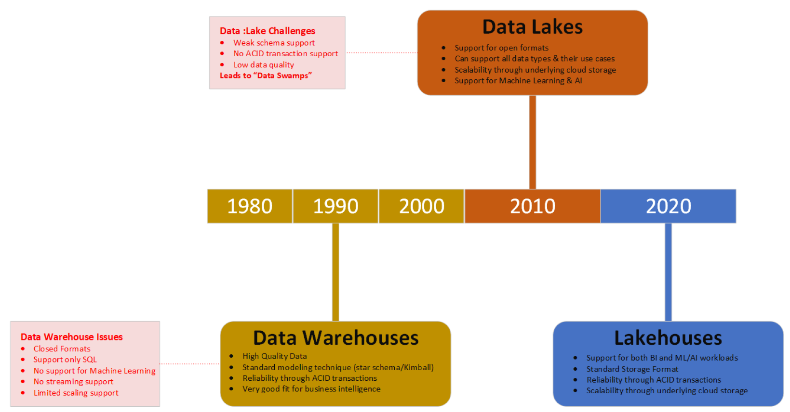
Evolution of Data Architectures
Compute / Analytics
Storage / Data Stores
NoSQL
(2010s)
Spark
(2010s)
Relational Database
(1960-1970)
HDFS
(2006)
MapReduce
(2006)
Delta Lake
(2021)

Slide 3
The Importance of an Optimal Storage Solution
Scalability and performance
Transaction support
Support for diverse data formats
Support for diverse workloads
Openness

Slide 4
Database
Designed to store structured data (i.e. table)
Can be read through SQL queries
Data adhere to a strict schema
allows database management system to heavily co-optimize data storage and processing through an optimized query processing engines
Very fast computation and strong transactional ACID guarantees on read/write operations
Atomicity, Consistency, Isolation, Durability (ACID)
OLTP vs. OLAP
Online transaction processing (OLTP): traditional databases
Online analytical processing (OLAP): Data Warehouse

Slide 5
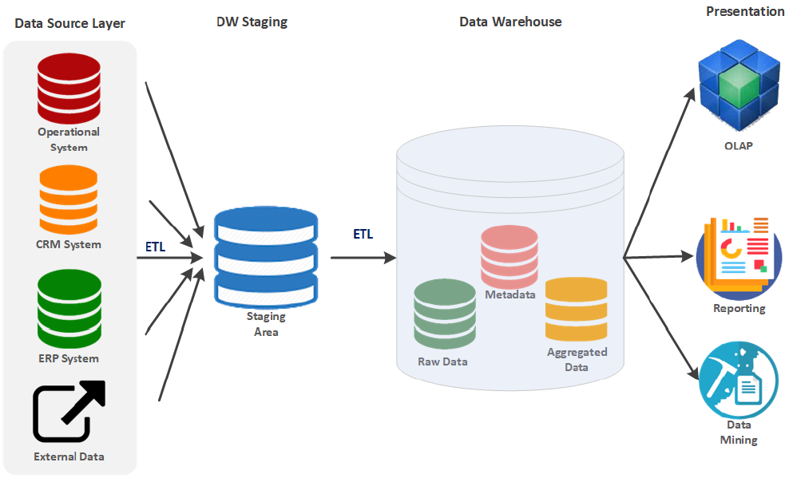
Data Warehouse
a central relational repository of integrated, historical data from multiple data sources

Slide 6
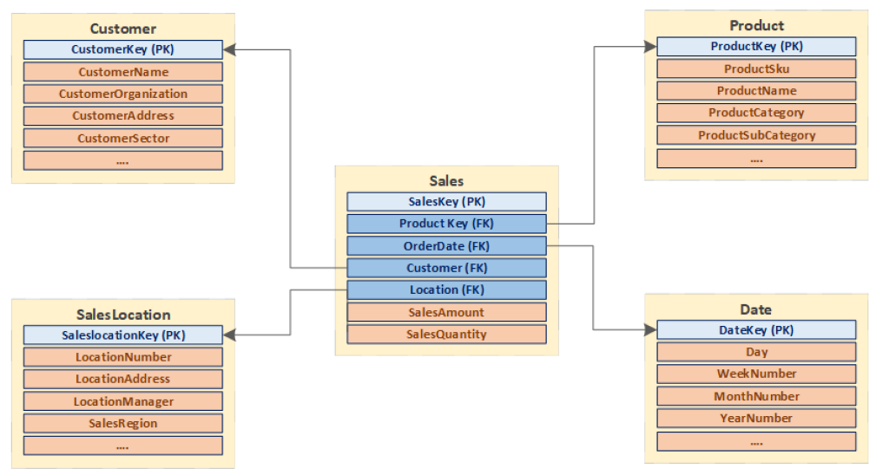
Dimensional Modelling

Slide 7
Data Warehouse Benefits & Challenges
Served the business community well
Store large amounts of historical data from different sources
Very reliable with strong transactional ACID guarantees
Modeled with standard star-schema modeling techniques
Ideally suited for business intelligence and reporting
Big Data Trends (Volume, Velocity, Variety, Veracity)
Growth in data sizes
Growth in the diversity of analytics
Data Warehouses have a hard time addressing Four Vs
Extremely expensive to scale out
Do not support non–SQL based analytics very well

Slide 8
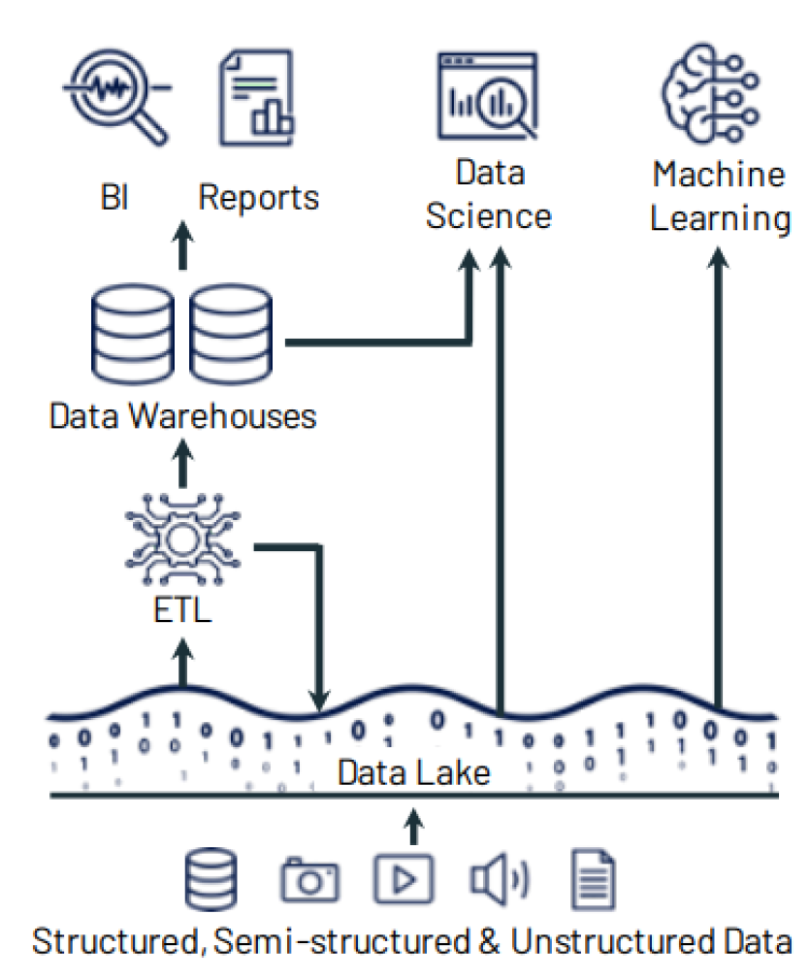
Data Lake
a cost-effective central repository to store data at any scale
a distributed storage solution, runs on commodity hardware, and easily scales out horizontally
data is saved as files with open formats
any processing engine can read and write them using standard APIs

Slide 9
Data lakes
decouples the distributed storage system from the distributed compute system
Allows each system to scale out as needed by the workloads
Organizations build their data lakes by independently choosing
Storage system: HDFS, S3, Cloud and etc.
File format:
Structured: Parquet, ORC
semi-structured: JSON
unstructured formats: text, images, audio, video
Computing / Processing engine(s):
batch processing engine: Spark, Presto, Apache Hive
stream processing engine: Spark, Apache Flink
machine learning library: Spark MLlib, scikit-learn, R

Slide 10
Data Lakes
Pros
Flexibility on choosing storage, data format and processing engines
A much cheaper solution than databases ➔ explosive growth of the big data ecosystem
Cons:
Fail to provide ACID guarantees
Building and maintaining an effective data lake requires expert skills
Easy to ingest data but very expensive to transform data to deliver business values
Data quality issues due to the lack of schema enforcement

Slide 11
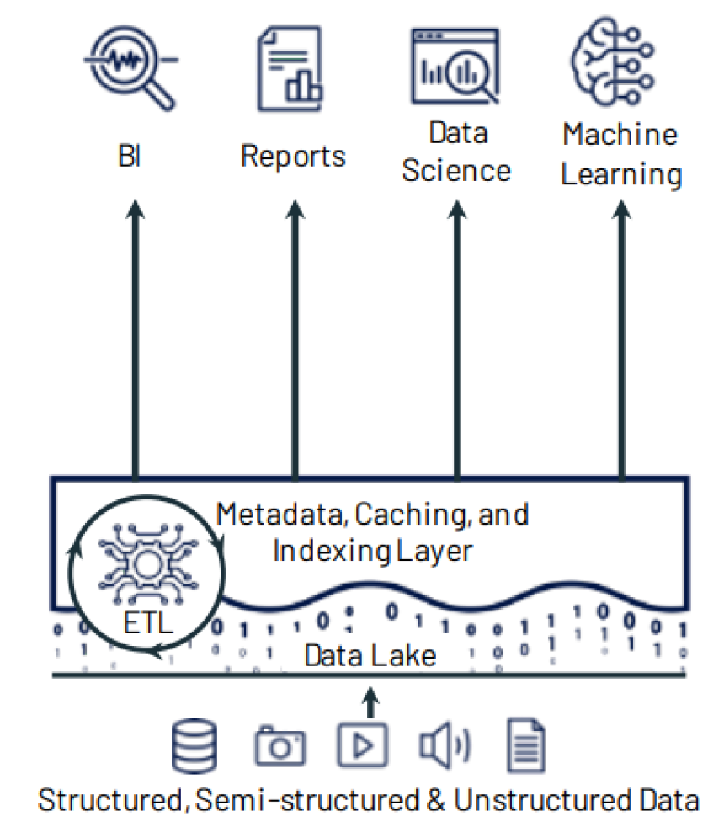
Data Lakehouse
A system merges both data lake and warehouse:
The flexibility, low cost, and scale of a data lake
The data management and ACID transactions of data warehouses
A good fit for both users:
Business intelligence
Machine Learning/AI
Especially good match for cloud environment
with separate storage and computing resources
Notes:
a new paradigm combines the best elements of data lakes and databases
Transaction support
Schema enforcement and governance
Support for diverse data types in open formats
Support for diverse workloads
Support for upserts and deletes
Data governance
Lakehouses solutions
Store large volumes of data in structured file formats on scalable filesystems
Maintain a transaction log to record a timeline of atomic changes to the data (much like databases)
Use the log to define versions of the table data and provide snapshot isolation guarantees between readers and writers
Support reading and writing to tables

Slide 12
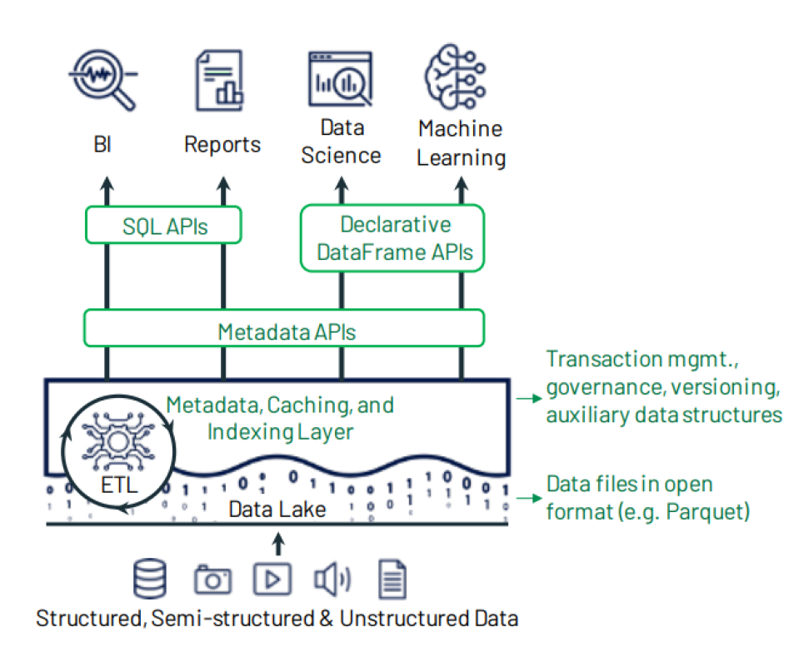
Data Lakehouse implementation

Slide 13
Delta Lake
the metadata, caching and indexing layer on top of a data lake storage that provides an abstraction level to serve ACID transactions and other management features
Transactional ACID guarantees
Full DML (Data Manipulation Language) support
Audit History
Unification of batch and streaming into one processing model
Schema enforcement and evolution
Rich metadata support and scaling

Slide 14
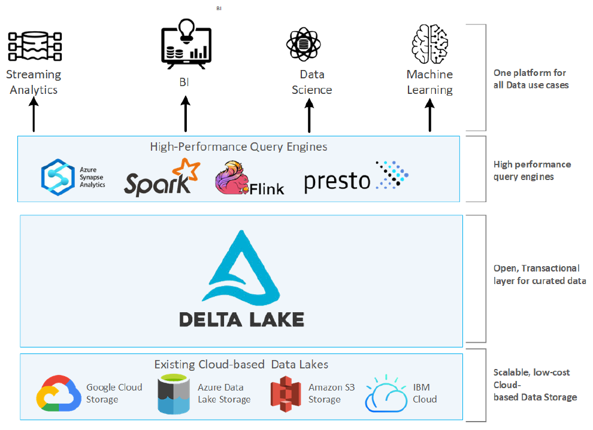
Data lakehouse Layered Architecture

Slide 15
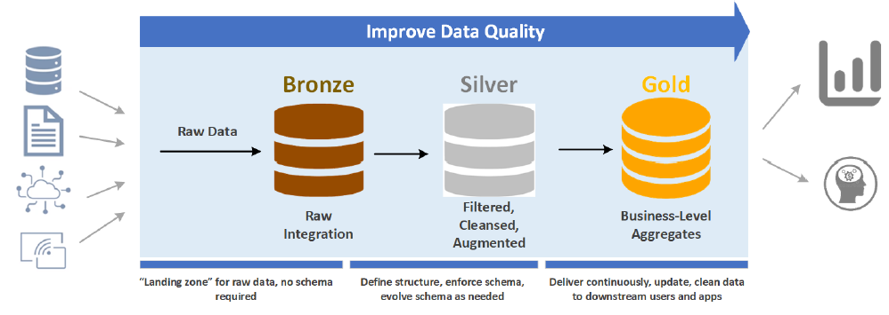
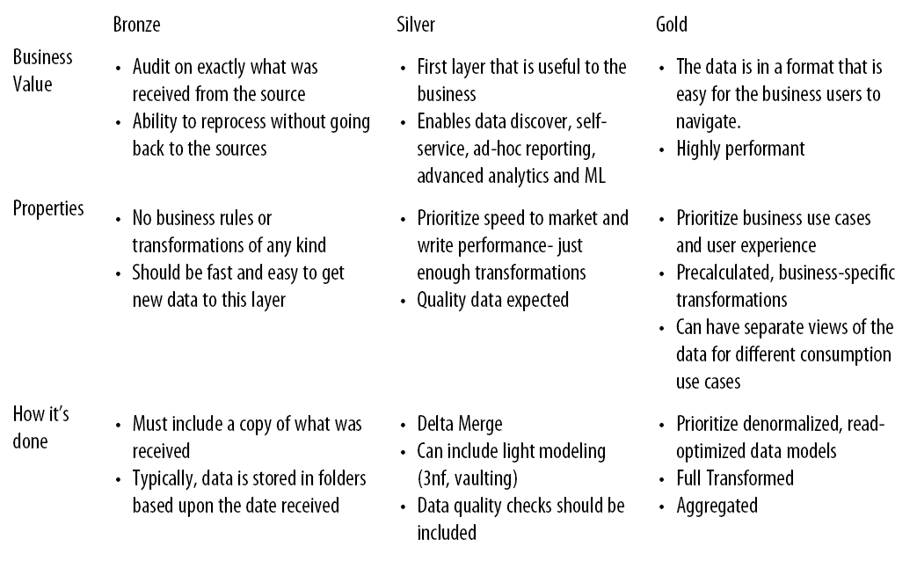
The Medallion Architecture

Slide 16
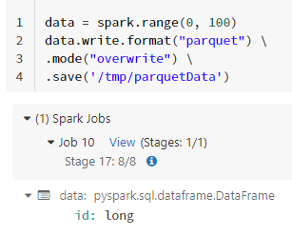
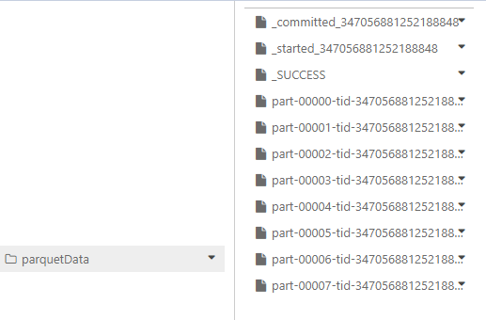
Delta Lake Format
a standard Parquet file with additional metadata
Parquet Files
Column oriented: perform compression on a column-by-column basis
Open source
Self-describing: actual data + metadata (schema & file structure)
Notes:
The Apache Parquet file format has been one of the most popular big data formats for
the last 20 years. Unlike row-based formats such as CSV or Avro, Parquet is column oriented,
meaning that the values of each table are stored next to each other, rather
than in each record. Second, Parquet is open source, so it is free to use under the
Apache Hadoop license and is compatible with most Hadoop data processing frameworks.
Parquet is self-describing. In addition to the actual data, it contains metadata,
including the schema and structure of the file.
Parquet files perform compression on a column-by-column basis and are built to
support flexible compression options and extendable encoding schemas for each data
type. For example, a different encoding can be used for compressing integer versus
string data.

Slide 17
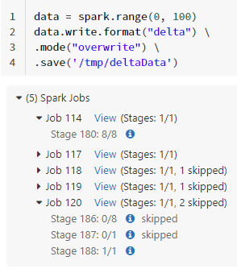
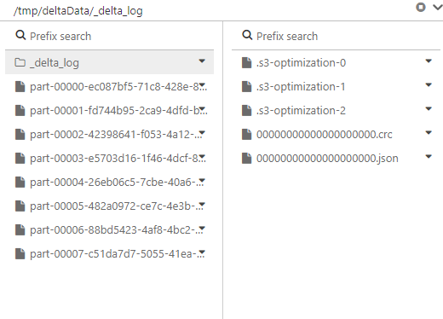
Demo_4

Slide 18
The Delta Lake Transaction Log (DeltaLog)
The transaction log is an ordered record of every transaction made against a Delta table since it was created.
It acts as a single source of truth and tracks all changes made to the table.
The main goal is to enable multiple readers and writers to operate on a given version of a dataset simultaneously.
It is at the core of many important features
ACID transactions
Spark looks at the transaction log to get the latest version of the table
If an operation is not recorded in the transaction log, it never happened.
Scalable metadata handling
Time travel

Slide 19
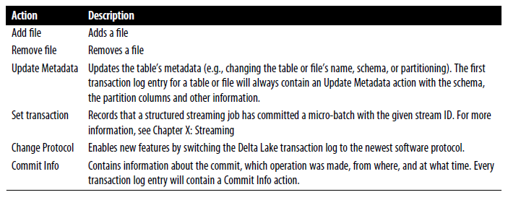
Breaking down Transactions into Atomic Commits
List of possible actions in a transaction log entry
Example: a user creates a transaction to add a new column to a table and then adds data to it
Update metadata – change the schema to include the new column.
Add file – for each new file added
Notes:
Whenever we perform a set of operations to modify a table or storage file, Delta Lake will break down that operation into a series of atomic, discrete steps composed of one or more of the actions shown below.

Slide 20
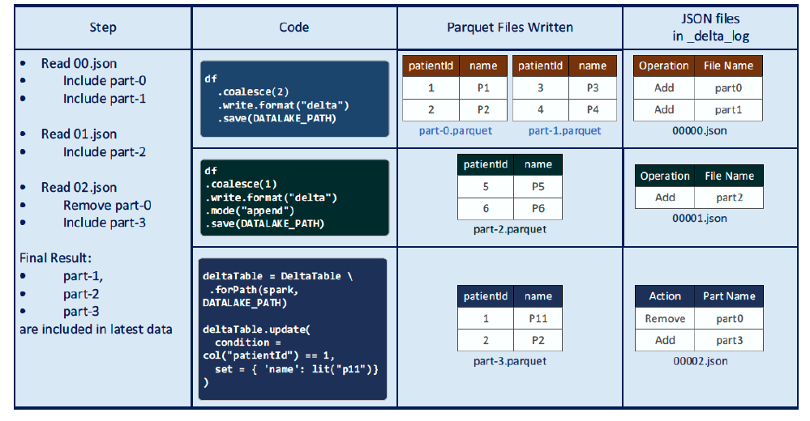
Delta Lake Example 1: Practical_4a
updates and the transaction log

Slide 21
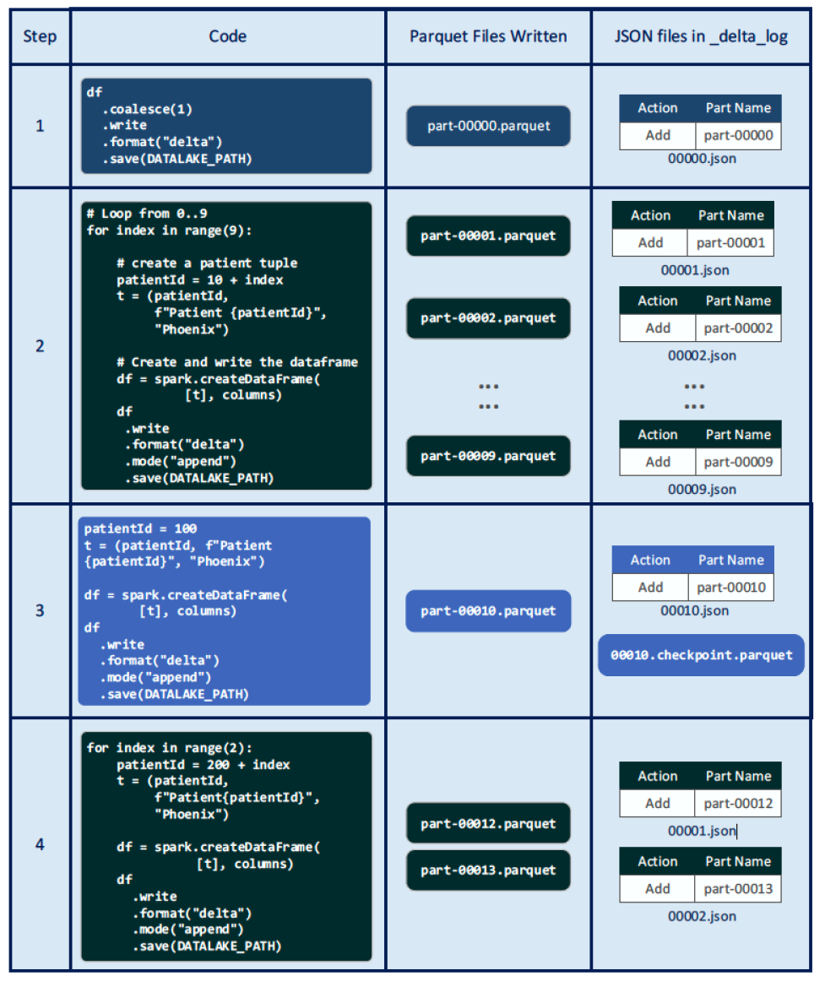
Delta Lake Example 2: Practical_4b
Checkpoint File

Slide 22
Acknowledgements
CS4225 slides by He Bingsheng and Bryan Hooi
Bennie Haelen, “Delta Lake: Up & Running”
Jules S. Damji, Brooke Wenig, Tathagata Das & Denny Lee, “Learning Spark: Lightning-Fast Data Analytics”
Bill Chambers, Matei Zaharia, “Spark: The Definitive Guide”

